Slide 1
KAOS Kyung Hee University Automatic Observing Software
v1 (20190227)
SNU Observatory Opening Ceremony Workshop:
Future of Small Telescopes in Korea
2019 Feb 27
Seoul National University Faculty Club
Soojong Pak
Tae-Geun Ji, Hye-In Lee, Jimin Han, Hojae Ahn (Kyung Hee University)
Myungshin Im (Seoul National University)

Slide 2
SW Roadmap of KHU IRLab
GMACS
(CDR)?
GMACS
(PDR)?
GMACS
(CoDR)
IGRINS
(McD 2.7m, DCT 4m, Gemini 8m)
Telescope Aperture
<1m 2m 3m 20m
CQUEAN
(McD 2.1m)
SQUEAN
(McD 2.1m)
KAOS
2008
2010
2012
2014
2016
2018
2020
2022

Slide 3
Uniqueness of KAOS
All-in-One SW for Small Telescopes (Off-the-Shelf HW)
Based on SW Engineering Method (same as GMACS SWC)
Universal (astronomical, general, common) SW: KAOS Series
KAOS30: McDonald 30inch Telescope
KAOS76: Kyung Hee Univ. 76cm Telescope
KAOS10: Stellavue SV102ED 101mm Telescope

Slide 4
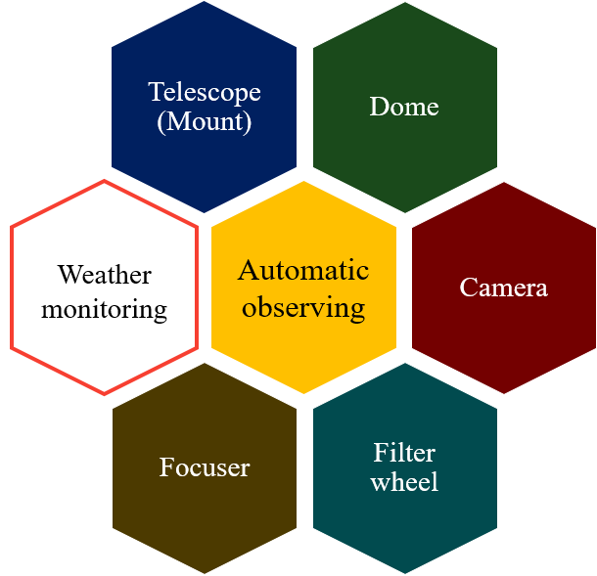
All-in-One SW

Slide 5
SW Engineering Methods in KAOS (or GMACS SWC) • Agile SW Development • Model Based Structure

Slide 6
Principles of SW Development
Reliability
Model-based structure
Agile management process
Maintainability
Cost-effectiveness

Slide 7
Why do we need SW Engineering?
One Professional
SW Engineer
Develop
Paper
Learn
Develop
Paper
Learn
Develop
Many
Students
Paper
Learn
Develop
Paper
Learn
Develop
Paper
Learn
Develop

Slide 8
SW Engineering Methods in KAOS (or GMACS SWC) • Agile SW Development • Model Based Structure

Slide 9
Sequential Development Process (GMACS SWC)
1. User Level Requirement (SE Team)
2. Engineer Level Requirement (Electronics & Mech. Team)
3. Requirement Definition (SW Team)
CoDR
4. Operation Scenario Definition (SW Team)
5. Graphic User Interface (GUI) Design (Developed by SW Team. Feedback by SE and Go to 3)
PDR
6. Function Definition (SW Team)
CDR
7. Coding (SW Team)

Slide 10
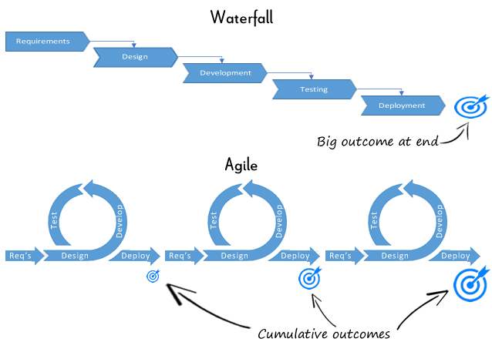
Agile SW Development
Stage-Gate Model
or Waterfall Model (i.e., sequential flowing from one phase down to the next)
Agile Development Process (i.e., iterative and incremental development process that encourages flexibility and adapts rapidly to changing needs and requirements)

Slide 11
SW Engineering Methods in KAOS (or GMACS SWC) • Agile SW Development • Model Based Structure

Slide 12
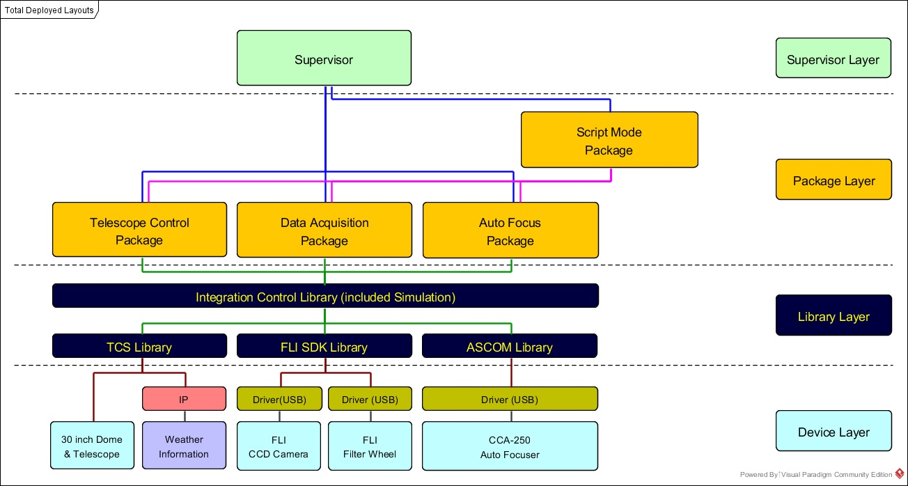
SW System Architecture (KAOS30)

Slide 13
SW Packages (KAOS30)
Telescope Control Package (TCP)
Real-time interworking of 30 inch Telescope & Dome
Automatic stop process via weather monitoring
Data Acquisition Package (DAP)
Science data acquisition
Display & Analysis of Image data
Auto Focus Package (AFP)
Focus adjustment (Manual / Auto)
Script Mode Package (SMP)
Enable automatic observation

Slide 14
Model Based Structure Design
Analysis of Requirement Elements
Design using Unified Model Language
(e.g., GMACS FCS-P)
Element ID | Requirement | Initiator | Responder | Status | In Charge | Classification
FCP-2 | FCP should start the compensation procedure of the align the optics components in real-time. | FCP | TwinCAT | planned | KHU | Compensation
FCP-2-1 | A user clicks ‘Start’ button, the FCP should start to calculate how far the laser beam from the center of the lateral sensors by reading the needed variables. | User | FCP | planned | KHU | Compensation
FCP-2-1-1 | FCP should display the calculated the offset position of the X-axis and the Y-axis. | FCP | User | planned | KHU | Compensation
FCP-2-1-2 | FCP should decide whether or not to proceed with the compensation procedure. The judgment factor must be predefined. | FCP | FCP | planned | KHU | Compensation
FCP-2-2 | FCP should calculate the adjusting values about 6-axis of the hexapods. | FCP | FCP | planned | KHU | Compensation
FCP-2-3 | Hexapods should adjust the 6-axis according to the compensation value of the FCP. | FCP | Hexapods | planned | KHU | Compensation

Slide 15
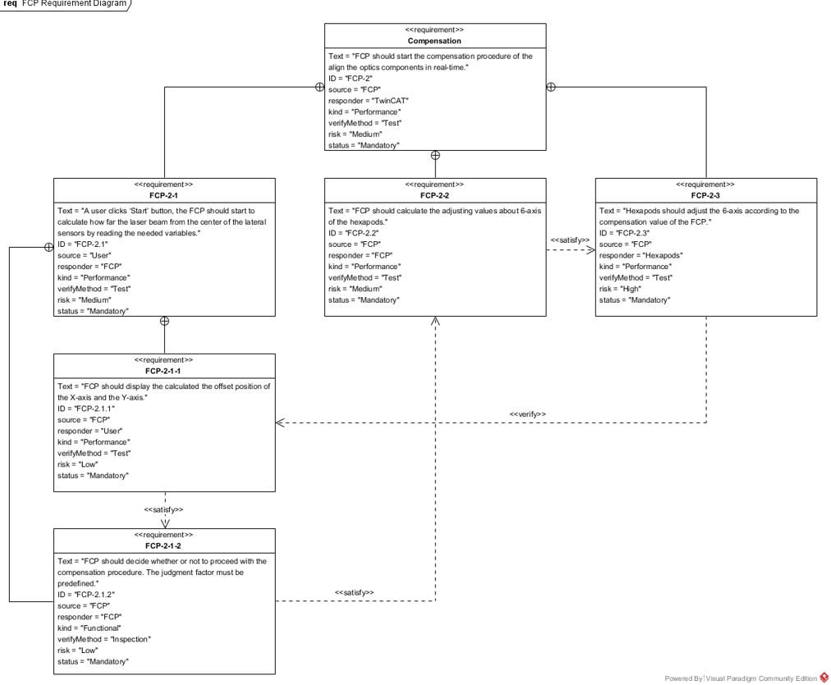
Hierarchy Structure Deployment
(e.g., GMACS FCS-P)

Slide 16
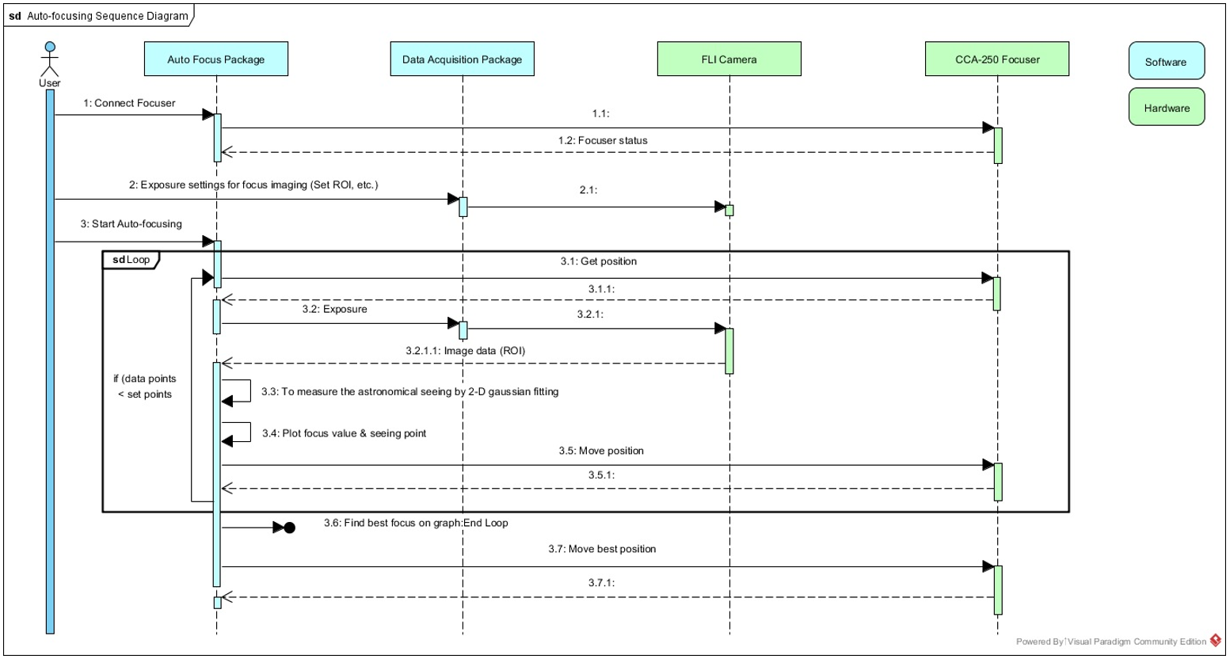
Operation Sequence Map
(e.g., KAOS30 Auto-focusing Package)

Slide 17
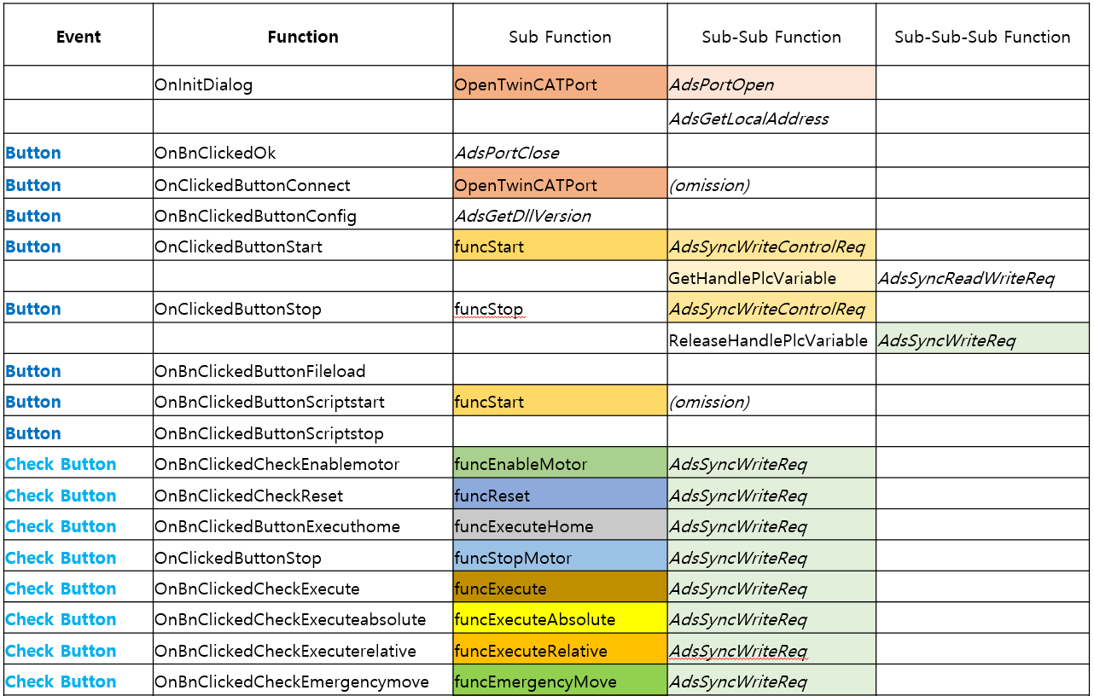
Function Definition
(e.g., GMACS SMEM-P)

Slide 18
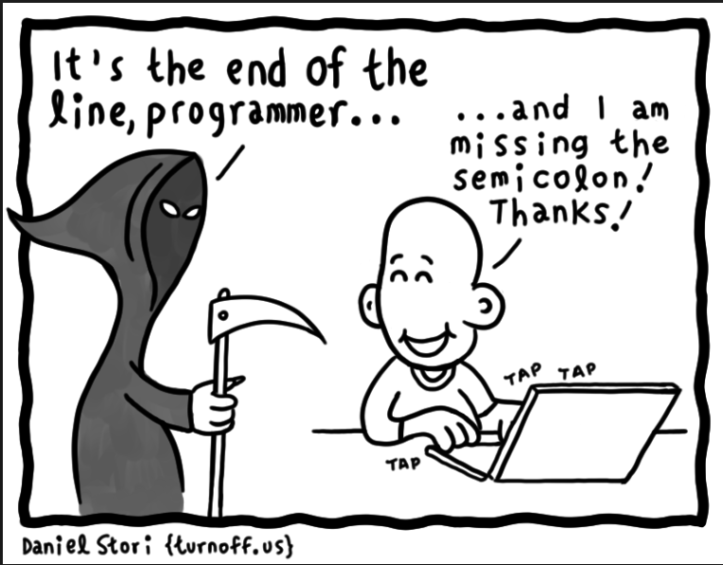
Coding......

Slide 19
KAOS Series • KAOS30: McDonald 30inch Tel. • KAOS76: KHAO 76cm Tel. • KAOS10: Stellavue SV102ED Tel.

Slide 20
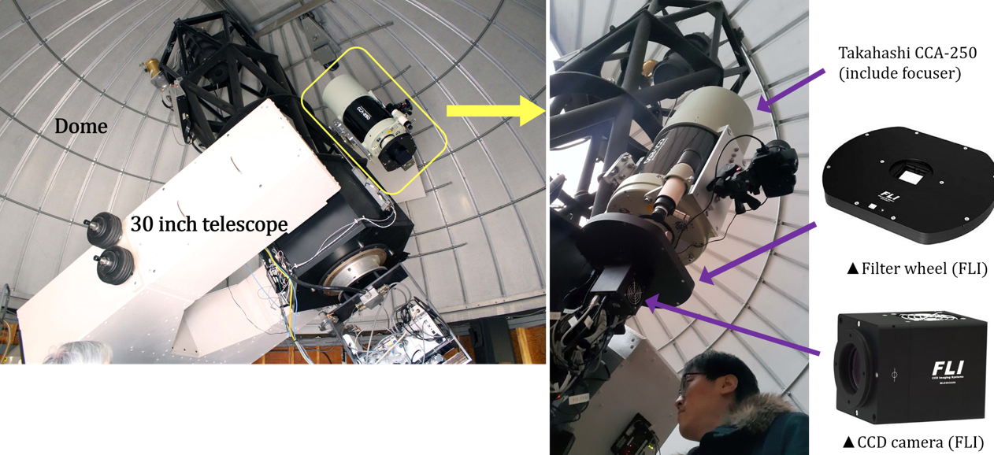
KAOS30
Takahashi CCA-250 (0.25m) telescope is mounted as a piggyback on 30inch telescope at McDonald Observatory (installed in 2017 Feb.).

Slide 21
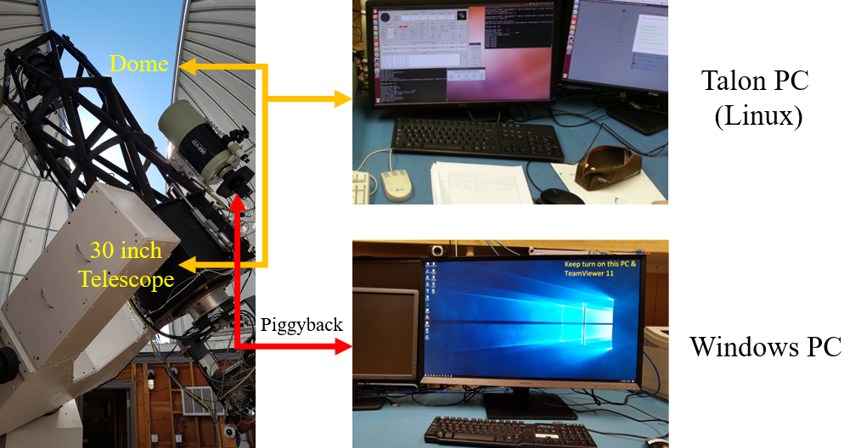
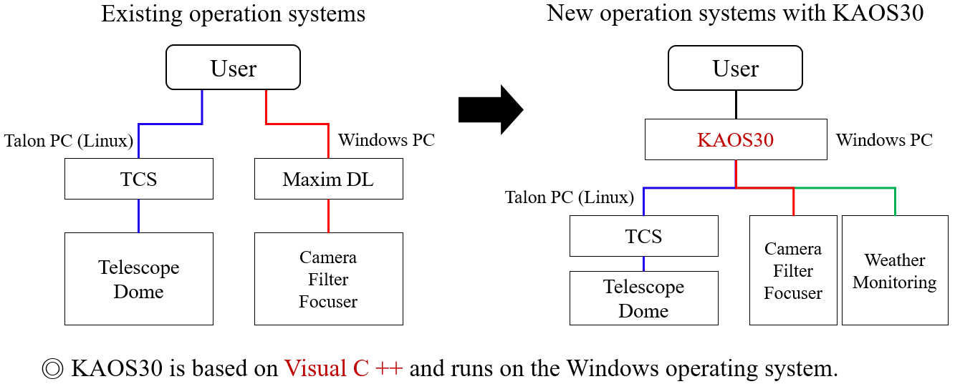
KAOS30 SW Architecture

Slide 22
System Architecture (KAOS30)

Slide 23
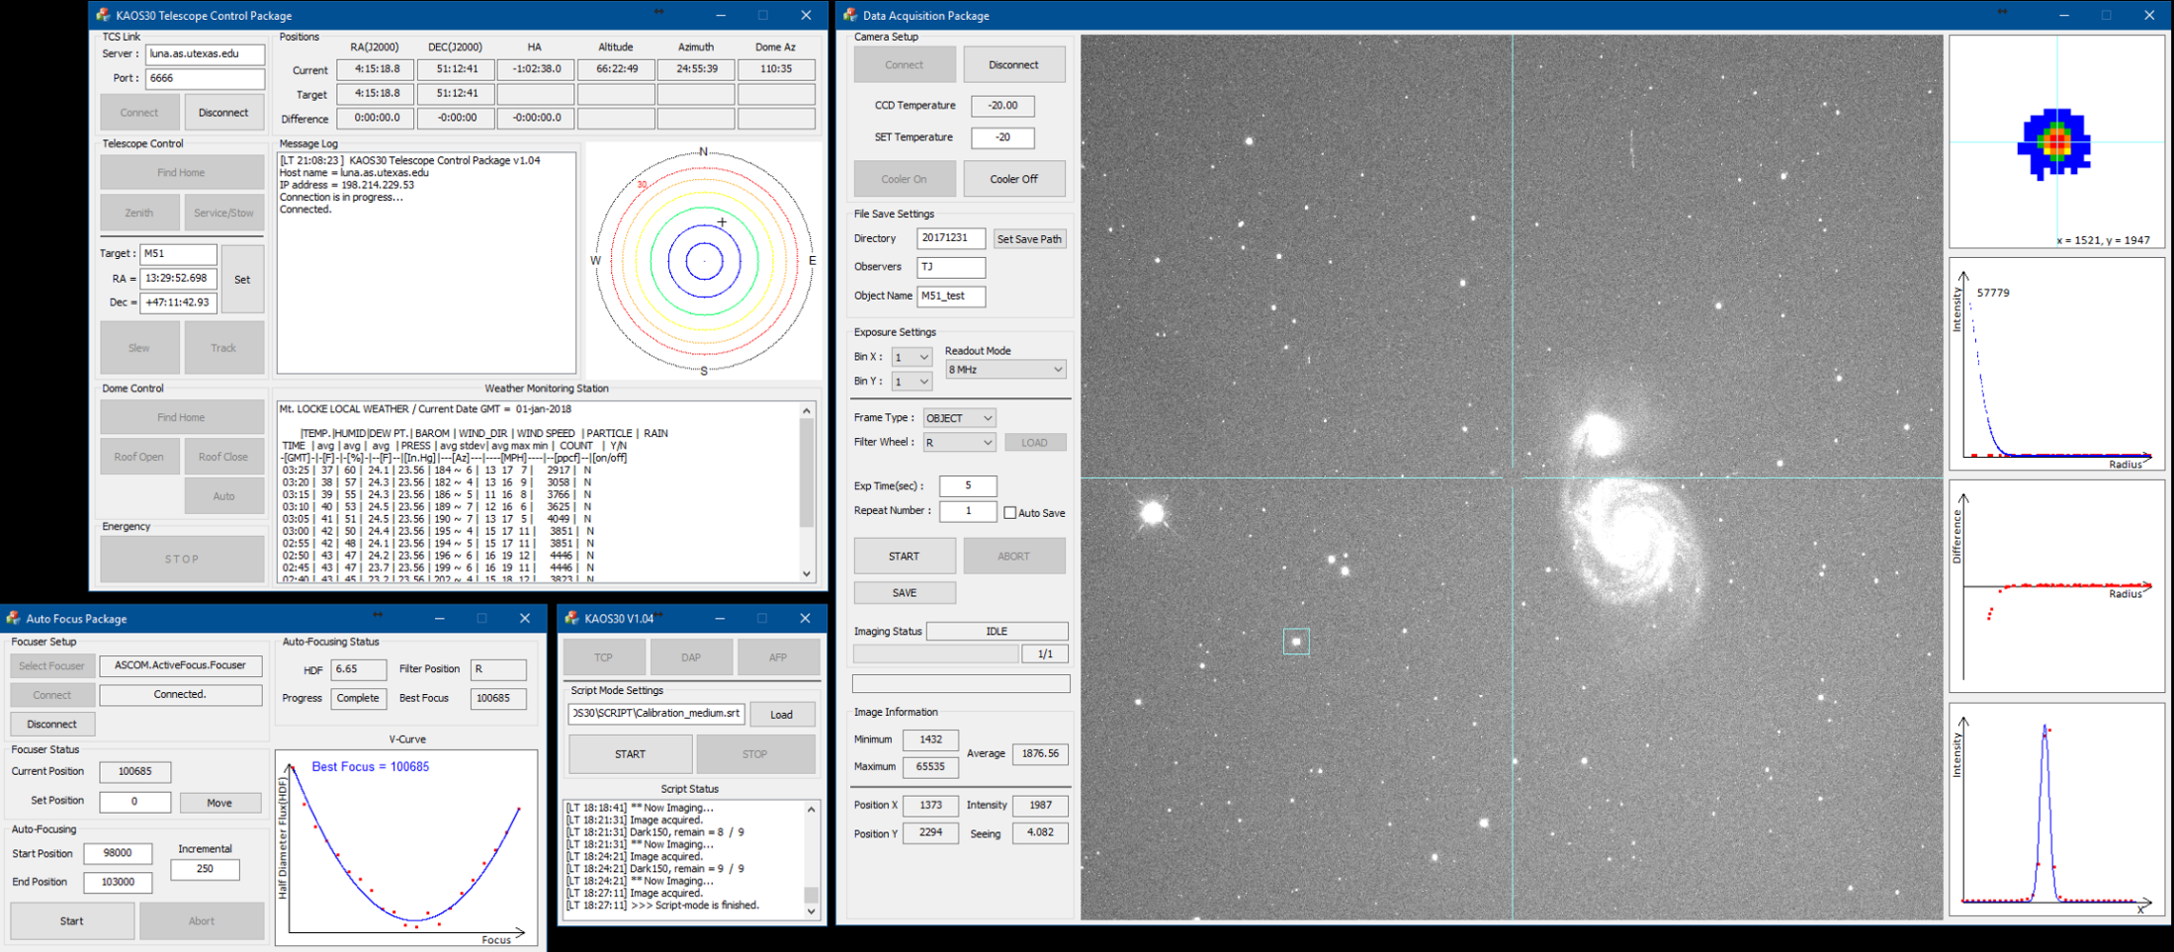
KAOS30 GUI
DAP
TCP
SMP
AFP

Slide 24
KAOS Series • KAOS30: McDonald 30inch Tel. • KAOS76: KHAO 76cm Tel. • KAOS10: Stellavue SV102ED Tel.

Slide 25
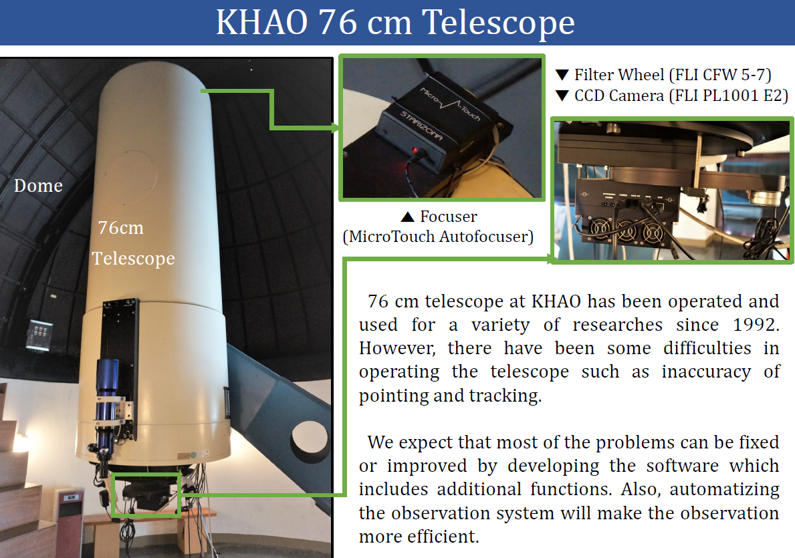
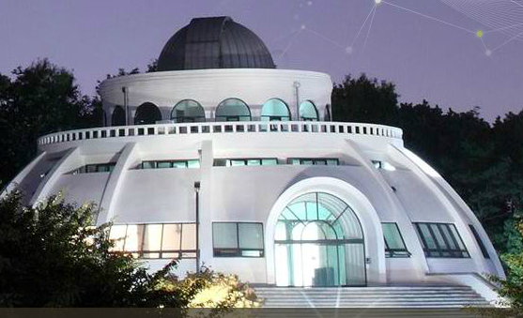
KAOS76
Kyung Hee University Astronomy Observatory was founded in 1992.

Slide 26
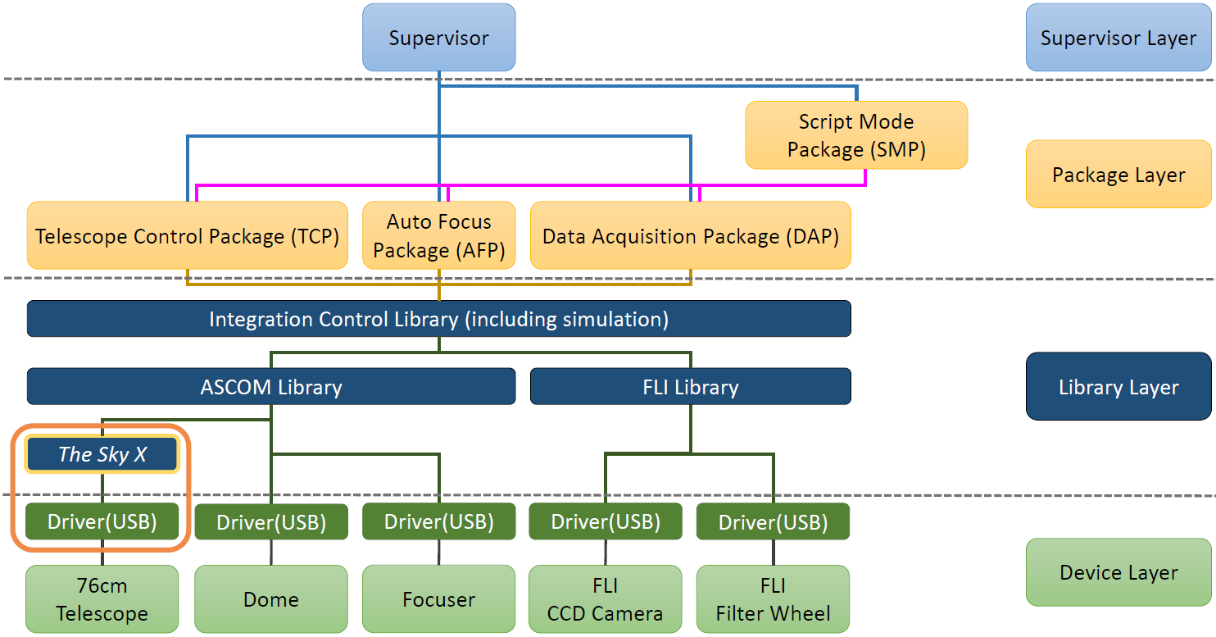
KAOS76 System Architecture
Visual C++ / Windows

Slide 27
KAOS Series • KAOS30: McDonald 30inch Tel. • KAOS76: KHAO 76cm Tel. • KAOS10: Stellavue SV102ED Tel.

Slide 28
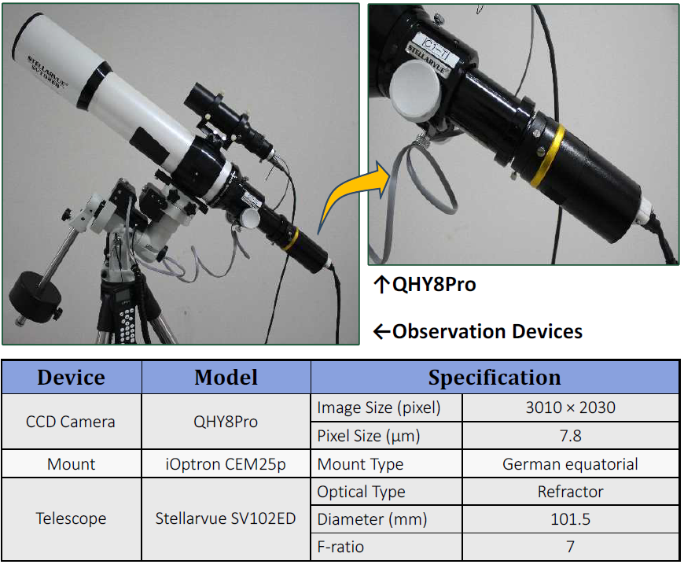
KAOS10

Slide 29
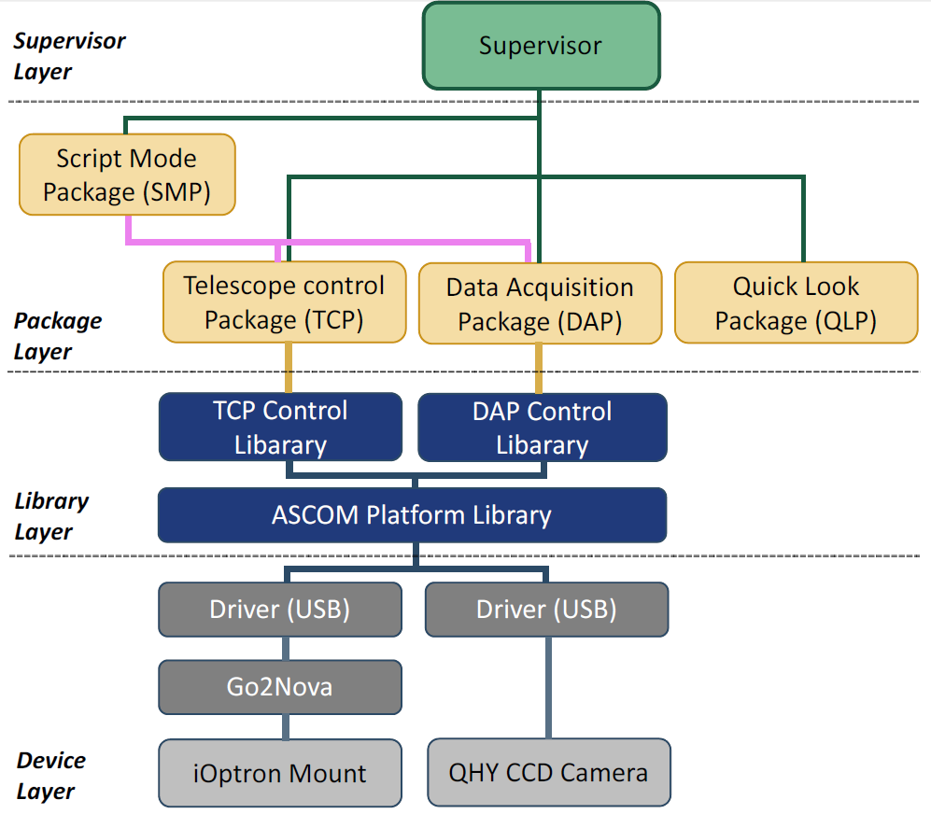
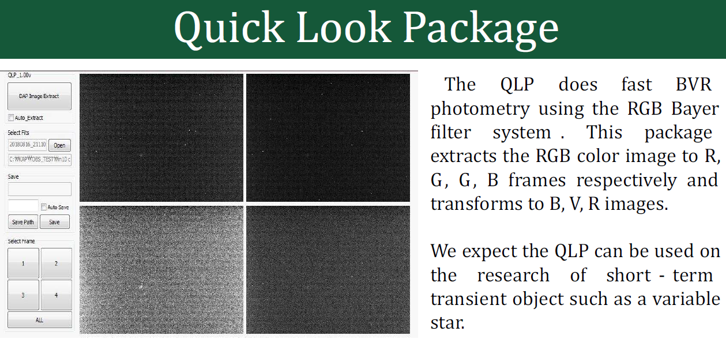
KAOS10 System Architecture
Visual C++ / Windows

Slide 30
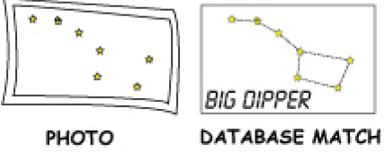
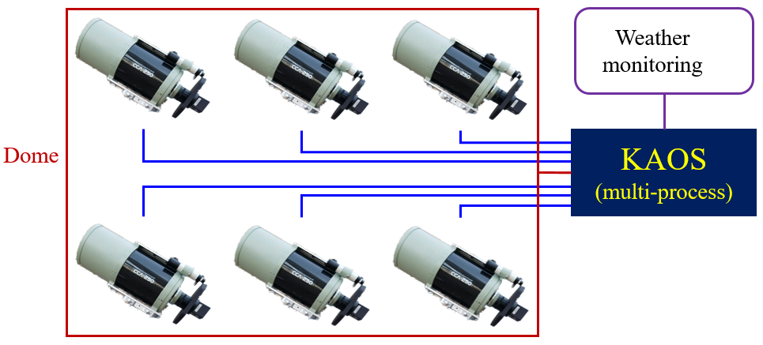
KAOS in the Future
Connecting Astrometry.net
Data Reduction Pipeline
Multi-Telescope Operation

Slide 31
Summary
We are developing KAOS Series, e.g, KAOS30, KAOS76, KAOS10.
KAOS is All-in-One SW for Small Telescopes using Off-the-Shelf HW Devices.
We are applying SW engineering methods.
Agile SW Development: Each iteration, students can make a product.
Model Based Structure: Several students participate several SW projects.

Slide 32
Thank you

